Slide 1
Distributed Database Systems
By
Syed Bakhtawar Shah Abid
Assistant Professor
Department of Computer Science

Slide 2
Basic concepts and Definitions
Data
Collection of facts and figures concerning an object or event
Stored representation of objects and events that have meaning and importance in the user’s environment
It is always in raw form

Slide 3
Basic concepts and Definitions
Information
Meaningful form of data
Processed form of data that can be used for decision making
Data that have been processed in such a way as to increase the knowledge of the person who uses the data

Slide 4
Basic concepts and Definitions
Meta Data
Data about data
Data that describe the properties or characteristics of end user data, and the context of that data

Slide 5
Basic concepts and Definitions
Data Base
An organized collection of logically related data.
A database is a shared collection of logically related data, and a description of this data, designed to meet the requirements of different users of an organization.

Slide 6
Basic concepts and Definitions
Data Base Management System (DBMS)
A software system that is used to create, maintain, and provide controlled access to user bases.
A software system that acts as an interface between the Database and user of the Database
A software system that acts as a shield to protect data base from direct unauthorized access.

Slide 7
Basic concepts and Definitions
Data Model
Graphical systems used to capture the nature and relationships among data
Enterprise Data Model
A graphical model that shows the high-level entities for an organization and the relationship among those entities

Slide 8
Basic concepts and Definitions
Entities
A person, place, object or event in the user environment about which the organization wishes to maintain data
Relationship
Association between data
Relation
A named two dimensional table of data.
Each relation consists of a set of named columns
And
An arbitrary number of un-named rows
Relational Database
A database that represents data as a collection of tables in which the relationships are represented by common fields in the related tables

Slide 9
Traditional File Processing System
A collection of application programs that perform services for the end-users such as the production of reports. Each program defines and manages its own data.

Slide 10
Disadvantages of T.F.P.System
Program Data Dependence
Duplication Of Data
Disadvantages of Duplication
Wastage of effort and time
Wastage of memory
Loss of data integrity
Limited Data Sharing
Low programmer productivity
Low enforcement of Data Standards
Problems of low data standard
Synonym
Homonym
Excessive program maintenance

Slide 11
Data Base Approach
A database is a shared collection of logically related data, and a description of this data, designed to meet the requirements of different users of an organization

Slide 12
Advantages of Data Base Approach
Program Data Independence
The separation of data descriptions from the application programs that uses the data is called data independence.
Planned Data Redundancy
Improved Data Consistency
Improved Data Sharing
Increased programmer productivity
Enhanced enforcement of data standards
Improved data Quality
By using integrity constraints
Reduced program maintenance

Slide 13
Components of the Data Base Environment
Data Base
DBMS
Repository
Application Programmer
Data Base Administrator
End Users

Slide 14
Three Schema Architecture
The three schemas are as follows
External Schema
Conceptual Schema
Internal Schema
Logical Schema
Physical Schema

Slide 15
External Schema
A logical description of some portion of the database that is required by a user to perform some task.
E.g.
User view1---→Report
User view2---→screen display
User view3---→order form
A view (or views) of the users of the database
E.g.
Managers
Other employees

Slide 16
Conceptual Schema
A detailed technology independent specification of the overall structure of the organizational data
Conceptual schema combines different external views into a single, coherent definition of the enterprise data.
It represent the view of the data architect or data administrator
Usually depicted in the graphical format using E-R modeling or Object modeling
Specification for the conceptual schema are stored as meta data in a repository or data dictionary

Slide 17
Conceptual Schema
The goals of the conceptual schema are
Scope in the entire organization or at least in a major business area
All entity types are included
All relationships are documented
All attributes, primary keys and secondary keys are included
Meta data and business rules are specified and stored in the repository

Slide 18
Internal Schema
Internal schema is divided into two types as follows
Logical schema
The representation of the data base for a particular data management technology
E.g.
Relational
Objected oriented
Network
Hierarchical
For example in a relational database
Tables are made
Keys are identified
Relations are normalized

Slide 19
Internal Schema
Physical schema
Specification for how data from a logical schema are stored in a computer secondary memory by a database management system
The physical schema describes the organization of physical records, the choice of file organization, the uses of indexes

Slide 20
Modeling entities and attributes
Entity:
a person, place, object or event in the user environment about which an organization wishes to maintain data.
Entity Type:
A collection of entities that shares common properties
Entity Instance:
A single occurrence of an entity type

Slide 21
Modeling entities and attributes
Entity types
Strong entity type
An entity type that exists independently of other entity types
The strong entity type is called the identifying owner
Weak entity type
An entity type whose existence depends on another entity type
Identifying relationship
The relationship between a weak entity type and its owner

Slide 22
Attributes
A property or characteristic of an entity or relationship type that is of interest to the organization.
Required VS Optional attributes
Simple VS Composite Attributes
Single Valued VS Multi Valued Attributes
Stored VS Derived Attributes

Slide 23
Relationship
Association between instances of entity types
Degree of Relationship
The Number of entity types that participates in the relationship
Unary Relationship
Binary Relationship
Ternary Relationship
Cardinality of Relationship
The number of instances of one entity type that must be associated with each instance of another entity type
One-to-One Relationship
One-to-Many Relationship
Many-to-Many Relationship

Slide 24
Data Base Design
Data models
a) Relational Data Model
b) Hierarchical Data Model
c) Network Data Model
d) Object Oriented Model

Slide 25
Relational Data Model
a) Relational Data Model
►First developed by E.F Codd in 1970
►Represents data in the form of table.
►Consists of the following three components.
▪ Data Structure
▪ Data Manipulation
▪ Data Integrity

Slide 26
Relational Data Model
Components of Relational Data Model
Data Structure : Data are organized in the form table with rows and columns.
Data Manipulation : Powerful operations are used to manipulate date stored in the relations.
Data integrity : By integrity we means completeness, accuracy and consistency of data. So facilities are included to specify business rules that maintains the integrity of data when it is manipulated.

Slide 27
Integrity Constraints
Domain integrity constraint
Entity integrity constraint
Referential integrity constraint
Action assertions constraint

Slide 28
Integrity Constraints
Domain integrity constraint
Domain : set of values that may be assigned to an attribute
All of the values that appears in a column of a relation must be taken from the same domain.
Entity integrity constraint
Primary key values can neither be duplicated nor be null.

Slide 29
Integrity Constraints
Referential integrity constraint
Association between tables are defined through the use of foreign keys.
A rule that states that each foreign key value must match a primary key value in another relation or the foreign key value must be null.
Foreign key value can be null in optional relation whereas must not be null in mandatory relation.

Slide 30
Integrity Constraints
Action Assertion Constraint
A statement of a constraint or control on the actions of an organization.
e.g. majoring a subject and its pre requisite course.

Slide 31
Relational Data Model
Relation : A named two dimensional table of data.
Each relation consists of a set of named columns
And
An arbitrary number of un-named rows.

Slide 32
Relational Data Model
Properties of relations
Have a unique name
An entry at the intersection of each row and column is atomic
Each row is unique – no two rows in a relation are identical
Each attribute (or column ) in a relation has a unique name
Sequence of columns is insignificant
Sequence of rows is insignificant

Slide 33
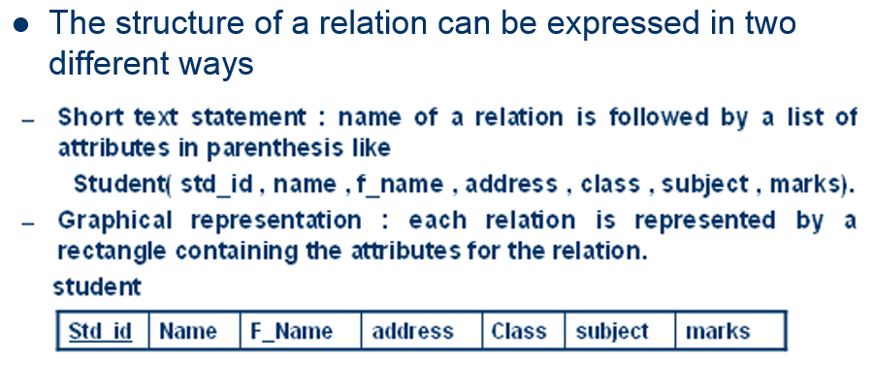
Relational Data Model

Slide 34
Relational Data Model
Relational Keys
Attribute (s) in a relation used to identify records.
Candidate key
Primary key
Alternate key
Simple key
Composite key
Secondary Key
Foreign key : an attribute in a relation of data base that serves as a primary key of another relation in the same data base.

Slide 35
Normalization
The process of decomposing relations with anomalies to produce smaller , well structured relations.
The analysis of functional dependencies is called normalization.

Slide 36
Functional dependency
A constraint between two attributes in which the value of one attribute is determined by the value of another attribute. i.e.
for any relation R, attribute B is functionally dependent on attribute A, if for every valid instance of A, that value of A uniquely determines the value of B and is represented as

Slide 37
Functional dependency
A constraint between two attributes in which the value of one attribute is determined by the value of another attribute. i.e.
for any relation R, attribute B is functionally dependent on attribute A, if for every valid instance of A, that value of A uniquely determines the value of B and is represented as A B

Slide 38
Functional Dependencies
An attribute may be functionally dependent on a single attribute or a collection of attributes as
Std_id , Course_Title Date Completed
Comma serves as a logical AND operator.
Other example.
SSN Name , address , DOB
VIN Make , Model , Color
ISBN Title , Author , Publisher

Slide 39
Functional Dependency
Determinant : An attribute in a relation that uniquely determine the value of another attribute.
The attribute(s) on the left hand side of the arrow is/are called determinant.
e.g.
Std_id , Course_Title
SSN
VIN
ISBN

Slide 40
Functional dependencies
1. Full functional dependency : A dependency in which the non key attributes are fully functionally dependent on the primary key.
2. Partial dependency : a functional dependency in which one or more non key attributes are functionally dependent on part (but not all ) of the primary key.
3. Transitive dependency: A functional dependency in which one attribute functionally determines a second, which functionally determines a third

Slide 41
Normalization
Steps in normalization.
Normalization is accomplished in stages, each of which corresponds to a normal form
Normal form : a state of a relation that results from applying simple rules regarding functional dependencies for relationship between attributes to that relation.

Slide 42
Well Structured Relation
A relation that contains minimal redundancy and allows the users to insert , modify , and delete rows in a table without errors or anomalies (inconsistencies).
Minimize data redundancy
Save storage space
Avoid data inconsistencies (anomalies) when insert, delete, and update rows.

Slide 43
Anomalies
Definition : an error or inconsistency that may result when a user attempts to manipulate a table that contain redundant data. The three types of anomalies are
Insertion Anomaly – as the primary key is the combination of both the emp_id and Course_Title, so to add a new employee, course information should be added.
Deletion Anomaly – deleting rows may cause a loss of data that would be needed for other future rows
Modification Anomaly – changing data in a row forces changes to other rows because of duplication
Emp_id | Course_Title | Date_Completed

Slide 44
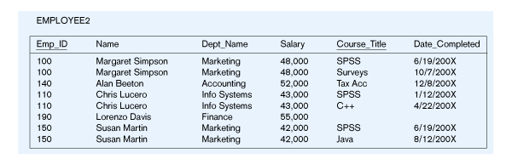
Example
Insertion – can’t enter a new employee without having the employee take a class
Deletion – if we remove employee 140, we lose information about the existence of a Tax Acc class
Modification – giving a salary increase to employee 100 forces us to update multiple records
Why do these anomalies exist?
Because we’ve combined two entity types into one relation. This results in duplication, and an unnecessary dependency between the entities

Slide 45
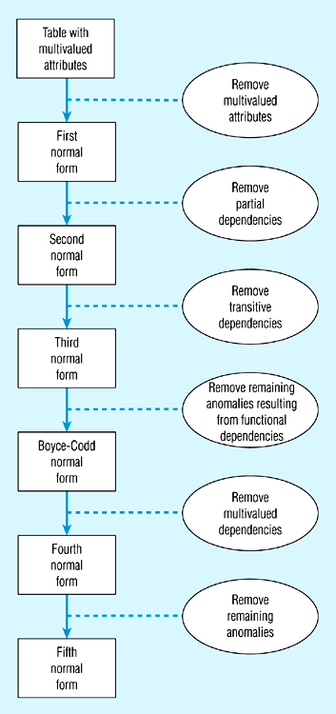
Steps in normalization
Normal form is a state of a particular relation regarding functional dependencies.

Slide 46
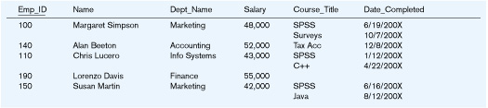
First Normal Form
No multivalued attributes
Every attribute value is atomic
Table 1is not in 1st Normal Form (multivalued attributes) ➔ it is not a relation
Table 2 is in 1st Normal form
All relations are in 1st Normal Form

Slide 47
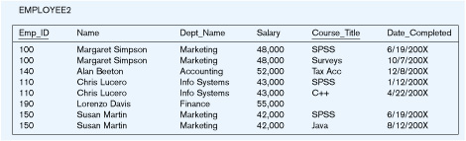
Second Normal Form
1NF plus No partial functional dependencies
Every non-key attribute must be defined by (fully functionally dependent on) the entire key, not by only part of the key
EMPLOYEE2 is NOT in 2nd Normal Form (salary is only dependent on Emp_id)

Slide 48
Functional Dependencies in EMPLOYEE2
Dependency on entire primary key
EmpID
CourseTitle
Name
DeptName
Salary
DateCompleted
Dependency on only part of the key
EmpID, CourseTitle ➔ DateCompleted
EmpID ➔ Name, DeptName, Salary
Therefore, NOT in 2nd Normal Form!!

Slide 49
Getting it into 2nd Normal Form
decomposed into two separate relations
Both are full functional dependencies
EmpID
Name
DeptName
Salary
EmpID
CourseTitle
DateCompleted

Slide 50
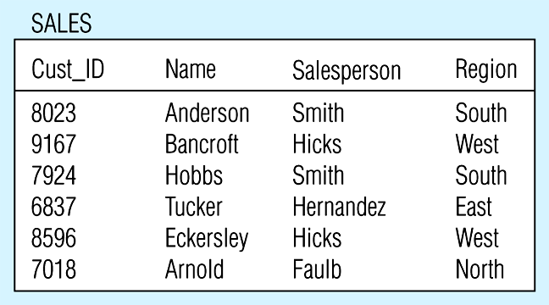
Third Normal Form
2NF PLUS no transitive dependencies
one attribute functionally determines a second, which functionally determines a third)
Sales is NOT in 3nd Normal Form (Region is depend on Salesperson)

Slide 51
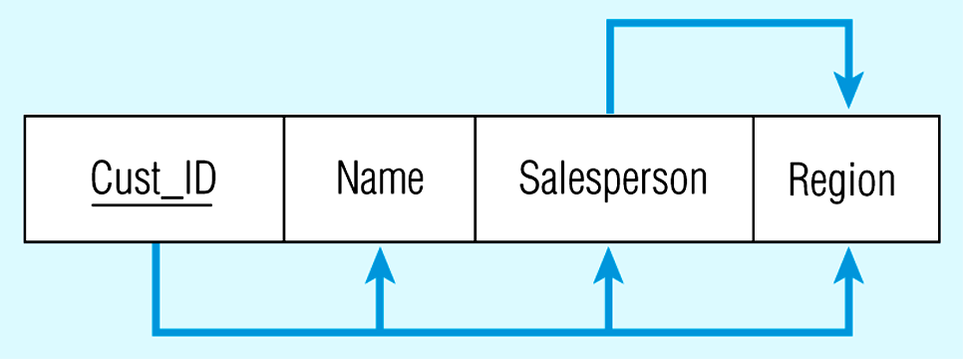
Relation with transitive dependency
CustID → Name
CustID → Salesperson
CustID → Region
All this is OK
(2nd NF)
BUT
CustID → Salesperson → Region
Transitive dependency
(not 3rd NF)

Slide 52
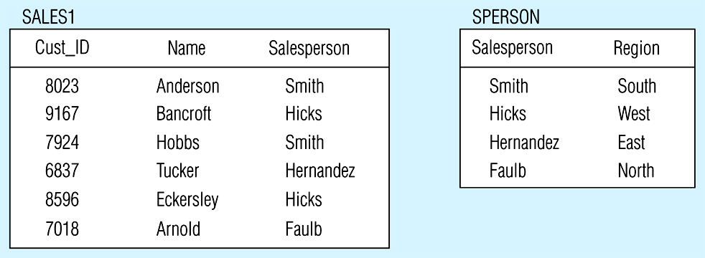
Removing a transitive dependency
Decomposing the SALES relation

Slide 53
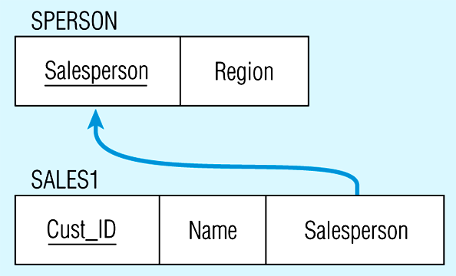
Relations in 3NF
Salesperson → Region
CustID → Name
CustID → Salesperson
Now, there are no transitive dependencies…
Both relations are in 3rd NF

Slide 54
Boyce Codd Normal Form
A relation is said to be in BCNF if and only every determinant is candidate key.
SID | Major | Advisor | GPA
1 | DB | Abid | 3.5
2 | C++ | Arshad sb | 3.6

Slide 55
Boyce Codd Normal Form
SID | Advisor | Major | GPA
But here partial dependency occurs between major and advisor
SID | Major | GPA
Major | Advisor

